Slide 1
Driver Drowsiness Detection System
CSE 495
3rd Presentation
Yakup Talha Yolcu
Project Advisor : Yrd. Doç. Dr. Burcu Yılmaz
January 2023

Slide 2
Content
Project Definition
Goal of the Project
What is done so far?
What could be done from now on?
Test Results
Success Criterias
Resources and References

Slide 3
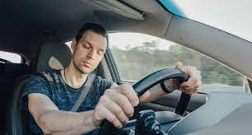

Project Definition
In this project we have a system that gives an alarm if driver is detected as drowsy.
Drowsiness detection works on two different situations :
If driver is closing their eyes for an amount of time
If driver can’t keep their head up for an amount of time (moves the head to any side without turning head)
When driver is detected as drowsy

Slide 4
What is done so far?
24.10-06.11 | 07.11-15.12 | 15.12-04.01 | 04.01-17.01
Get ready the hardware (Rasperry pi, camera etc…) Determine datasets to be used | Installing needed libraries to the hardware. Training models and compare models with each other to determine success rates. CHANGE IN THE TIMELINE!! | I decided continue with Python mediapipe library. I installed the required modules and I coded the necessary algorithm for 3 different situations. | I connected real alarm sound to computer. I tested program with different images
After second presentation I decided to change to datasets and libraries that I used so far. There is Python library called MediaPipe developed by Google. MediaPipe Face Mesh estimates 468 3D face landmarks in real-time

Slide 5
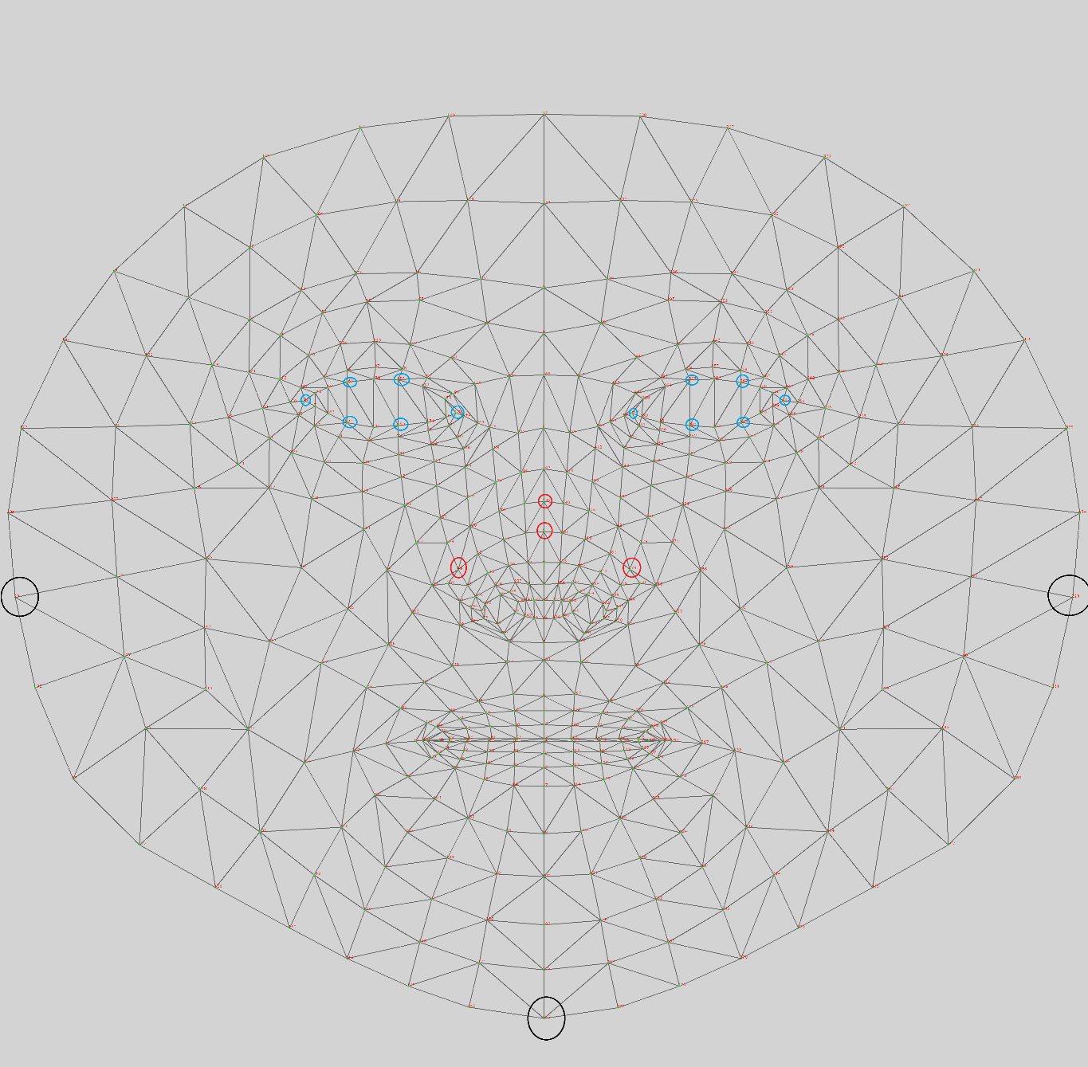
Explanation of MediaPipe
Check cheeks mode
right_cheek_index = 93
left_cheek_index = 323
chin_index = 152
Black indices : helps to check head is towards right or left, by looking angles between left cheek-chin and right cheek-chin
Eye situation will be explained in next slide.
Check head down mode
right_nose_index = 49
left_nose_index = 279
up_nose_index = 195
up_nose_index_2 = 5
Red indices : helps to check move is going down or not, I am deciding the drowsiness situation by looking y indices of the upper points. If their average becomes larger than the right and left points average, then this is drowsiness.

Slide 6
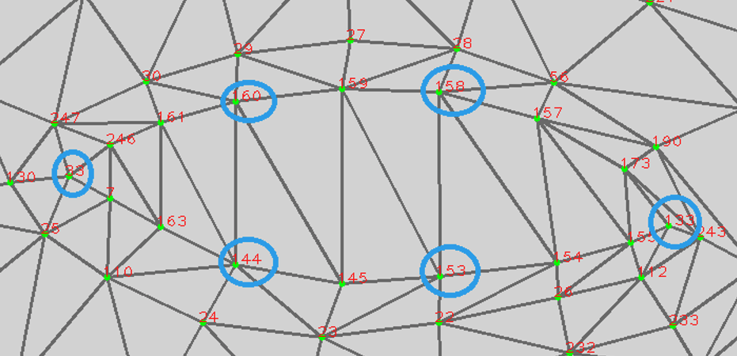
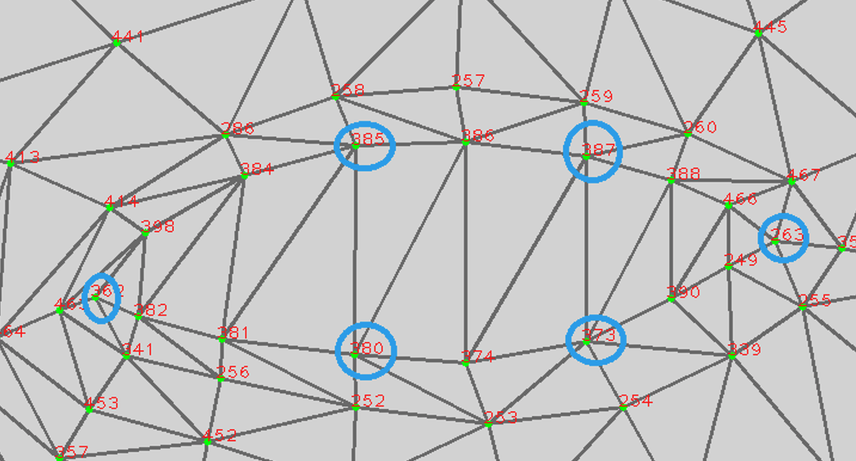
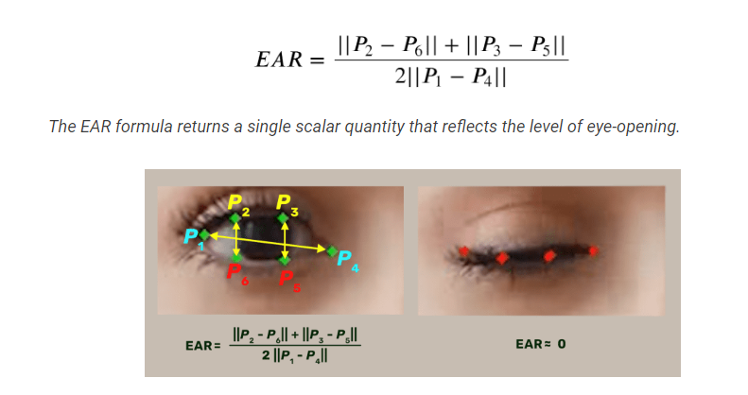
Explanation of MediaPipe - contd

Slide 7
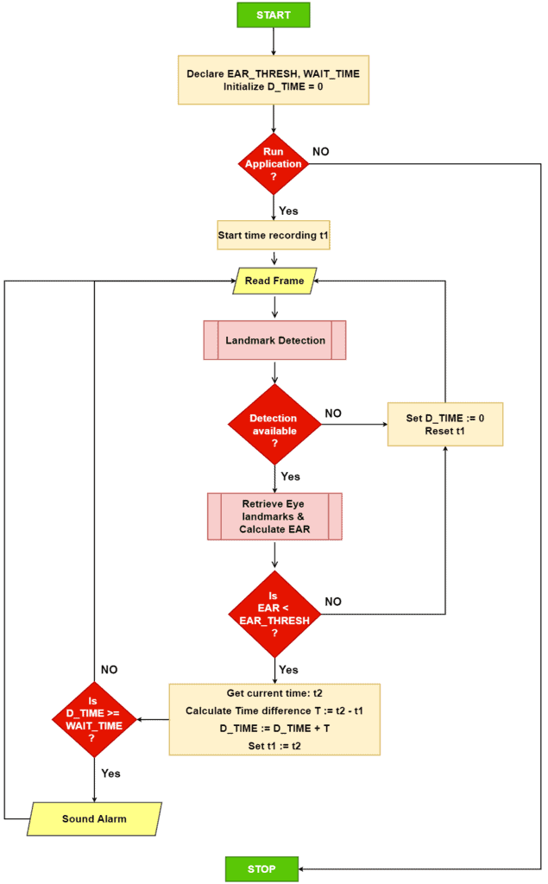
Flowchart of Program

Slide 8
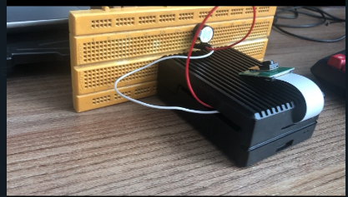
What could be done from now on?
Program is now running on Raspberry Pi, but with the additional hardwares next to it. To increase portability we can embed this hardware into driver panel.

Slide 9
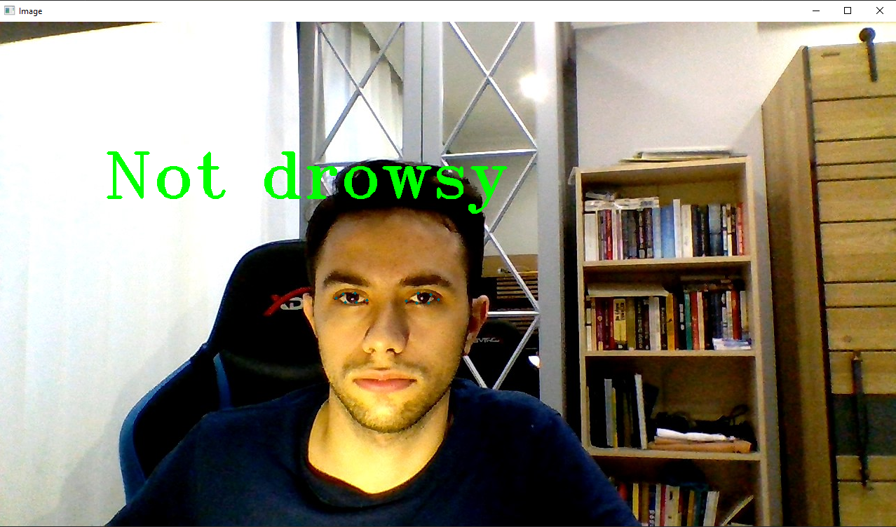
Test Results

Slide 10
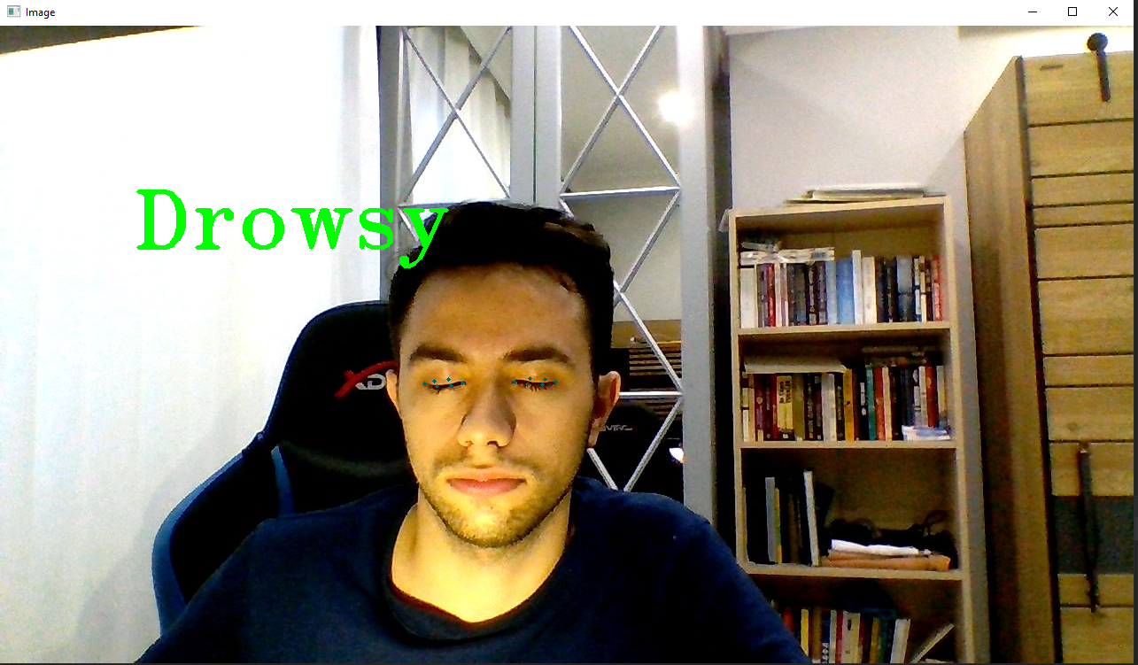
Test Results

Slide 11
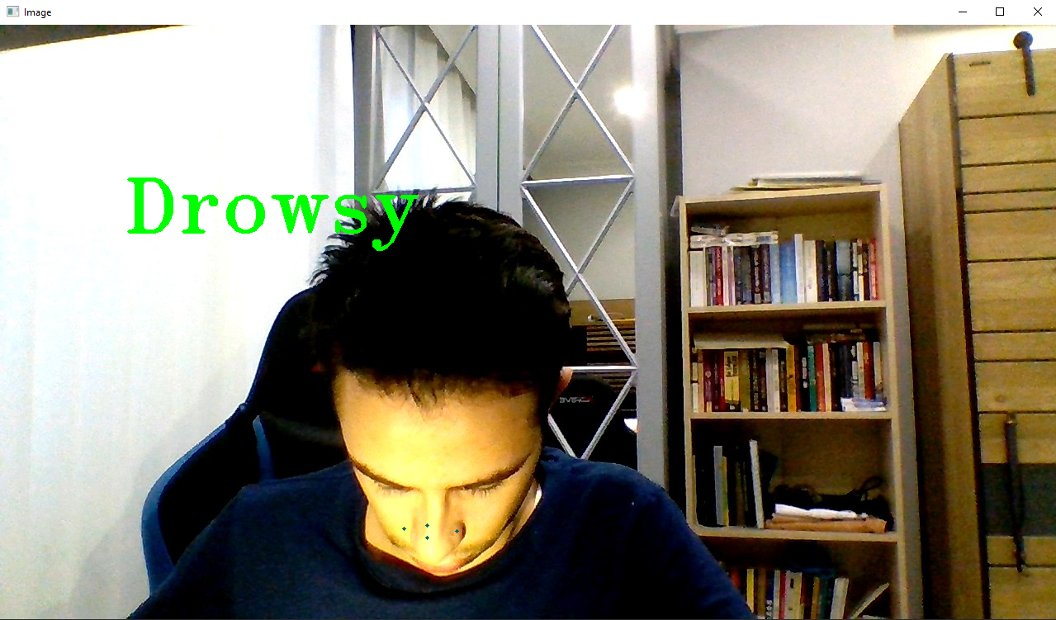
Test Results

Slide 12
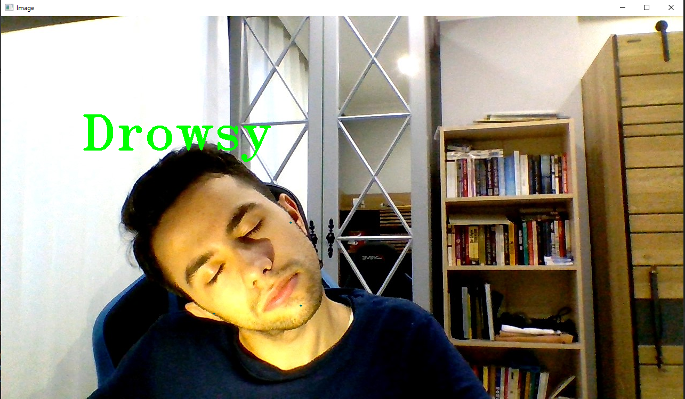
Test Results

Slide 13
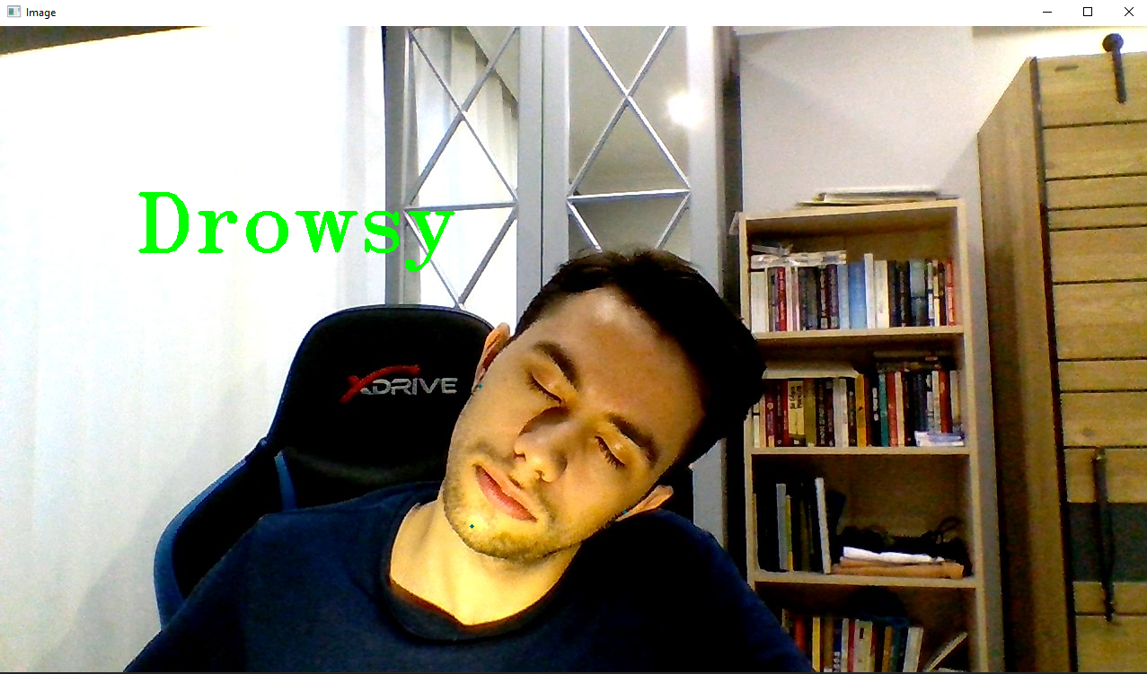
Test Results

Slide 14
Success Criterias
Predicting the drowsiness of the driver in 5 seconds at max.
This criteria is achieved, if the necessary conditions is achieved, because of computer does not make any complex computations, time can be adjusted into various numbers depend on the choice.

Slide 15
Resources and References
https://www.nauto.com/blog/introducing-driver-drowsiness-alerts (Drowsy driver in Project Definition page)
https://www.canstockphoto.com/the-view-inside-the-empty-car-the-54421487.html (Empty car inside view used in Project Design Page)
https://dergipark.org.tr/en/download/article-file/19838 (Analysis of Traffic Accidents in Turkey, Islim Sungur, Recep Akdur , Birgül Piyal)
Poursadeghiyan M, Mazloumi A, Nasl Saraji G, Baneshi MM, Khammar A, Ebrahimi MH. Using Image Processing in the Proposed Drowsiness Detection System Design. Iran J Public Health. 2018 Sep;47(9):1371-1378. PMID: 30320012; PMCID: PMC6174048.
Identification of Driver Drowsiness Using Image Processing K.Praveen Kumar, Srinivasa Rao Thamanam, M. Naresh Kumar
Gilbile, P., Bhore, P., Kadam, A., Balbudhe, K. (2019). Driver’s Drowsiness Detection Using Image Processing. In: Pandian, D., Fernando, X., Baig, Z., Shi, F. (eds) Proceedings of the International Conference on ISMAC in Computational Vision and Bio-Engineering 2018 (ISMAC-CVB). ISMAC 2018. Lecture Notes in Computational Vision and Biomechanics, vol 30. Springer, Cham. https://doi.org/10.1007/978-3-030-00665-5_70
https://www.sciencedirect.com/science/article/pii/S2667241322000039#:~:text=(2)%20EARM%20(%20t%20),as%2011%20in%20this%20experiment
https://learnopencv.com/driver-drowsiness-detection-using-mediapipe-in-python/

